Slide 1
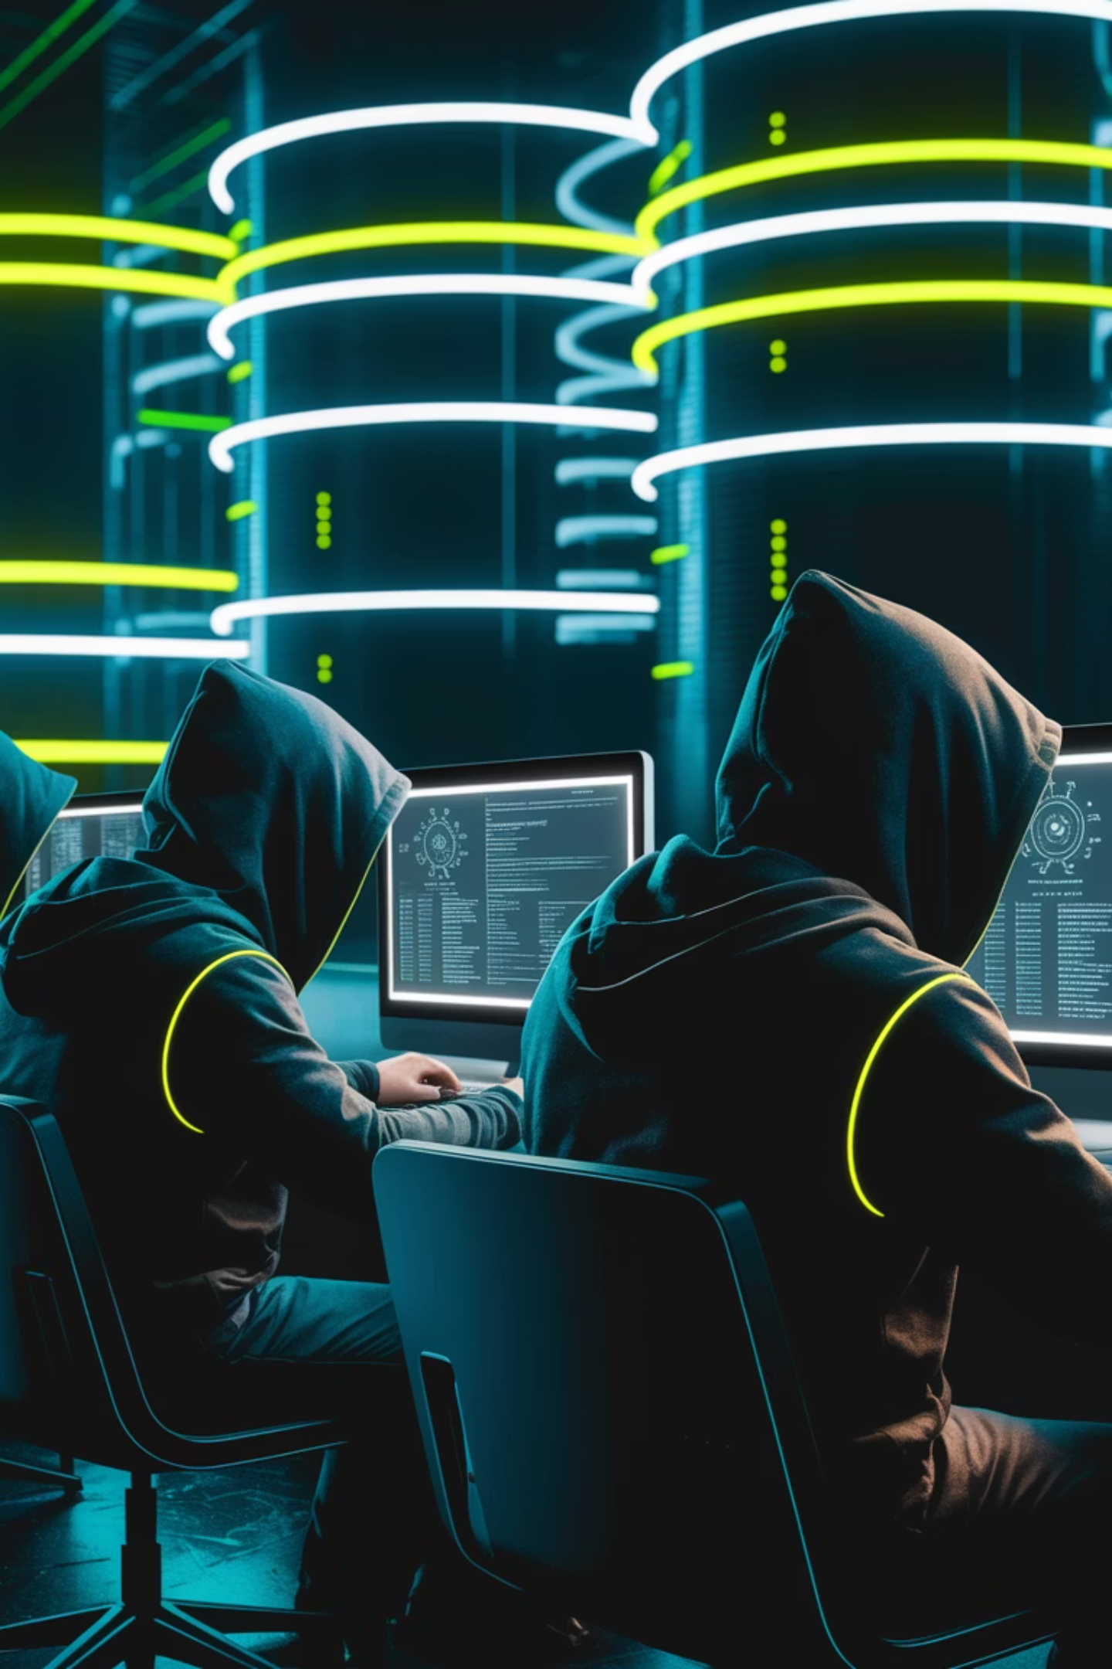
Xbox Underground: The Hackers Who Stole the Future
A True Story of Hacking, Espionage, and FBI Takedown.
By: Dennis Freyman

Slide 2
The Genesis – Where It All Began
Obscure online forum
The birth of Xbox Underground
passionate gamers discussing the possibility of infiltrating internal networks
collective united by the promise of unmasking a future that belonged only to the elite few
Fueled by excitement and armed with coding
mission: break the boundaries of what was possible.

Slide 3
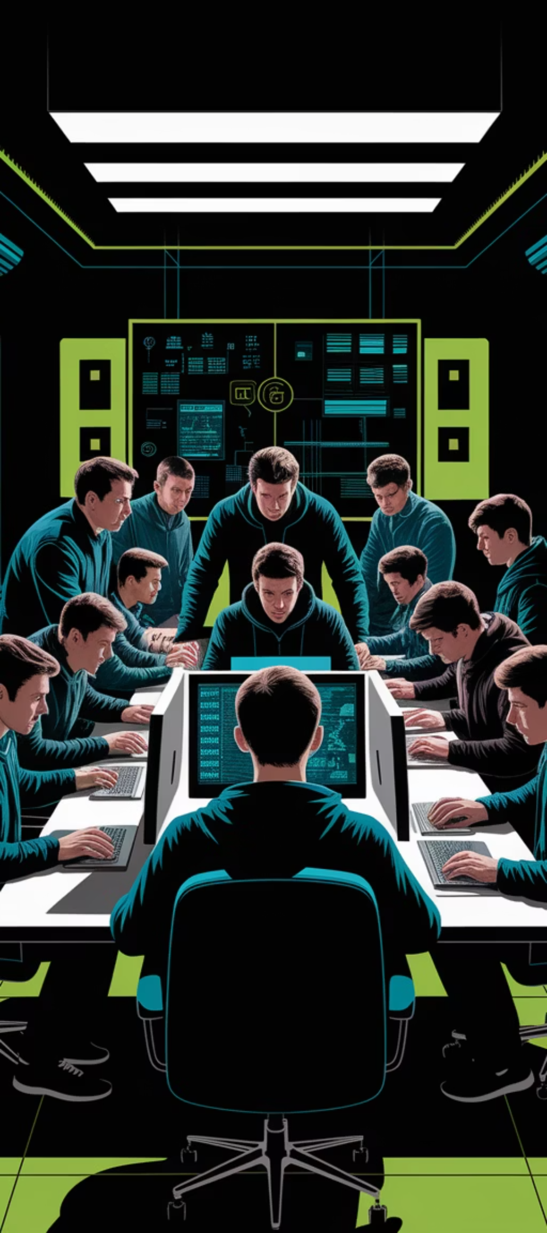
Assembling the Dream Team
1
Meet the Hackers:
SuperDaE (Dylan Wheeler) – The reckless mastermind, based in Australia.
David Pokora – The quiet genius, a strategist.
Nathan Leroux & Austin Alcala – The coders who took it to the next level.
A network of underground hackers, all obsessed with gaming.
2
The Team
they were a family bound by shared ambition and an insatiable curiosity.
each member’s unique skill was vital
they were forming a brotherhood

Slide 4
The Lure of the Unreleased – Why Games Were Worth the Risk
The gaming world wasn’t just a pastime—it was a universe
Every file was a tantalizing glimpse into a future
Capture the future
The risk was justified by the passion for gaming

Slide 5

Planning the Heist
1
Gathering intelligence on Microsoft’s internal networks
2
Multi-layered strategy
Every detail mattered
3
Anticipating countermeasures devising a plan

Slide 6
The Social Engineering Gambit
Even the most secure systems could be compromised
People are inherently helpful and trusting
humans are always the problem
and thats the problem

Slide 7

The Digital Vault
The team moved swiftly to breach Microsoft’s internal developer network
lateral movement
The hackers employed sophisticated VPN exploits
hide tracks, navigate layers of security undetected
“Project Titan” and “Halo Evolution”
changing gaming history

Slide 8
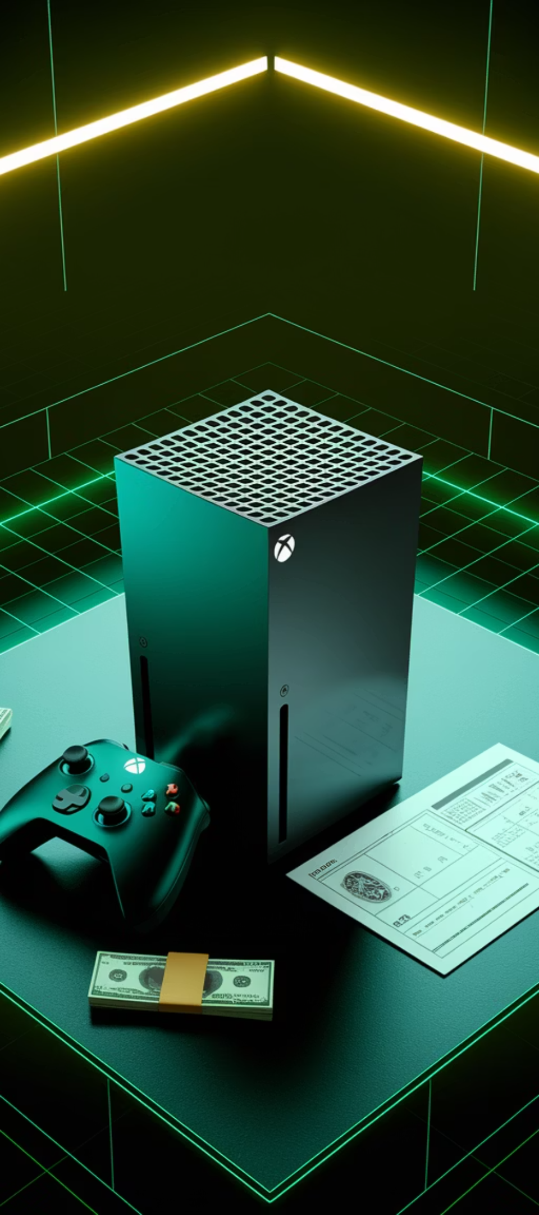


The Holy Grail
The ultimate prize: The complete blueprint of the next-generation Xbox
A digital Pandora’s box

Slide 9



The Prototype Heist
Covert pickup location
2
Using a backdoored Microsoft account
1
Crossed into the realm of physical, tangible rebellion
3

Slide 10



The eBay Listing
SuperDaE made a fateful decision
Exposing themselves to a wider audience
Beginning of their downfall

Slide 11
The Accidental Military Breach – Crossing the Line
Classified training simulations
Not part of their original plan.
Should they pull back
Stakes were far higher

Slide 12

Internal Turmoil
1
Tension within the crew escalated.
2
Growing shadow of imminent danger.
heavy disagreements regarding morality
where should they draw the line
3
Misstep could unravel their entire operation

Slide 13

The FBI Closes In
—
—
No longer under their control
FBI began piecing it all together
—
Panic set in
the crew more or less knew their time was coming soon
lots of fear
betrayal

Slide 14
The Takedown – Arrests, Confessions, and Shattered Dreams
The Climax
FBI agents
Testimonies
swift
found the crew across multiple countries
remorse
ruthless
acceptance
one by one

Slide 15



Aftermath and Legacy
Story became a legend
2
fueled by passion
Members
and a true love of gaming
some faded
1
others went public to share the story
Lesson
no system is inpenetrable
3
dont go too far

Slide 16
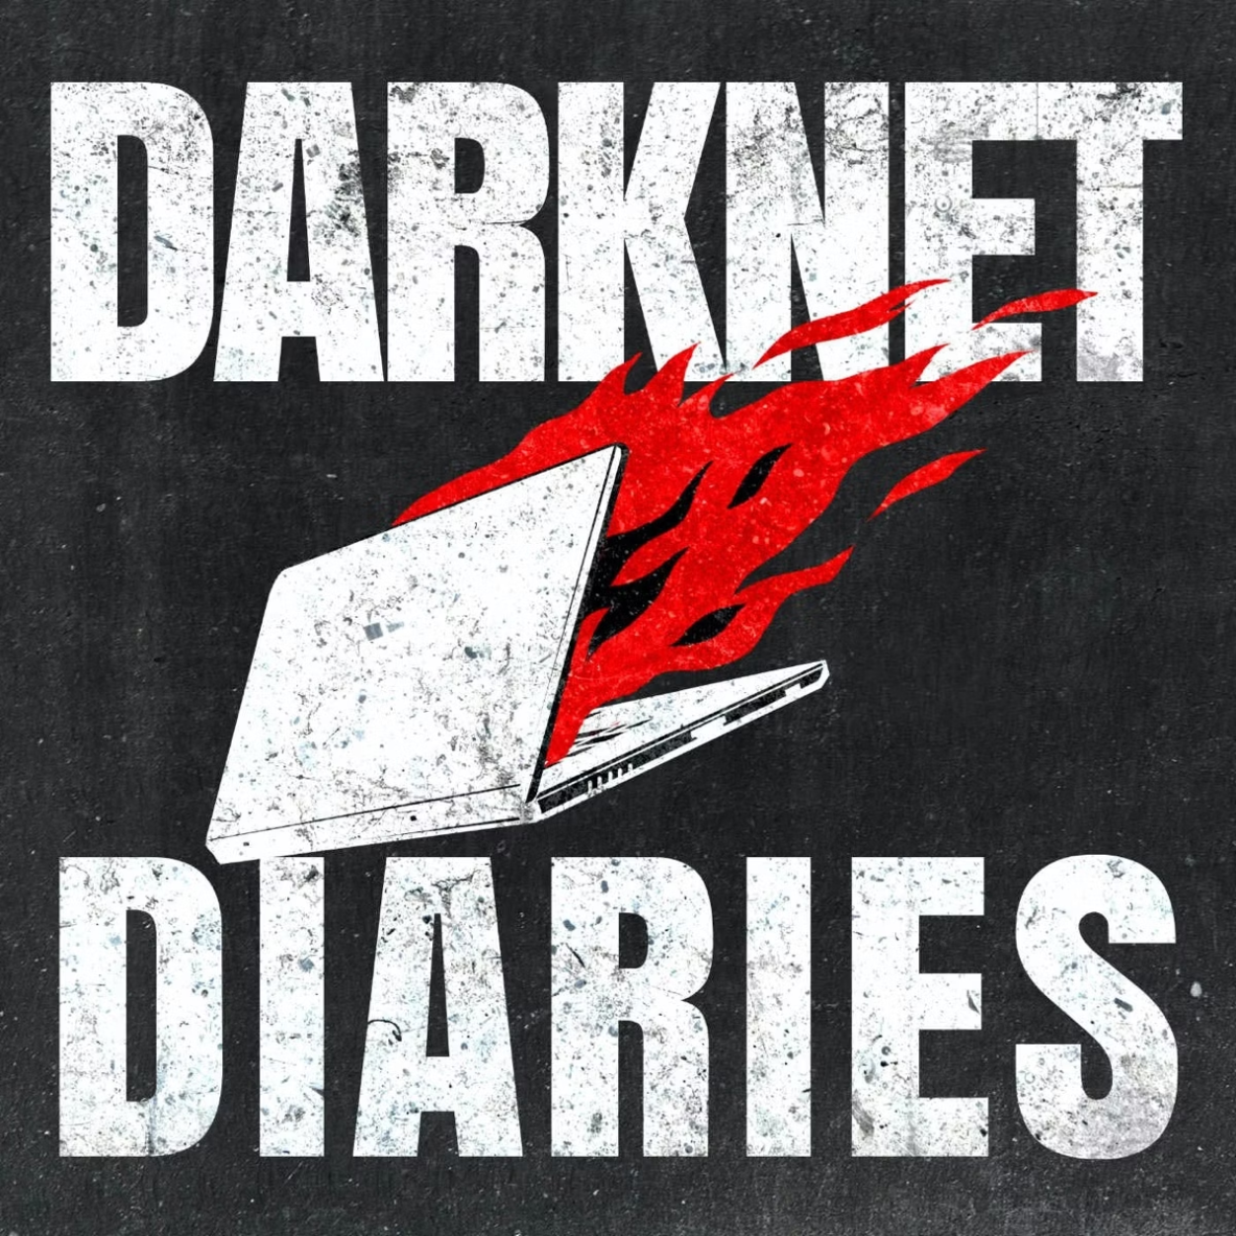
If you want to know more
Darknet Diaries - EP. 45

Slide 17
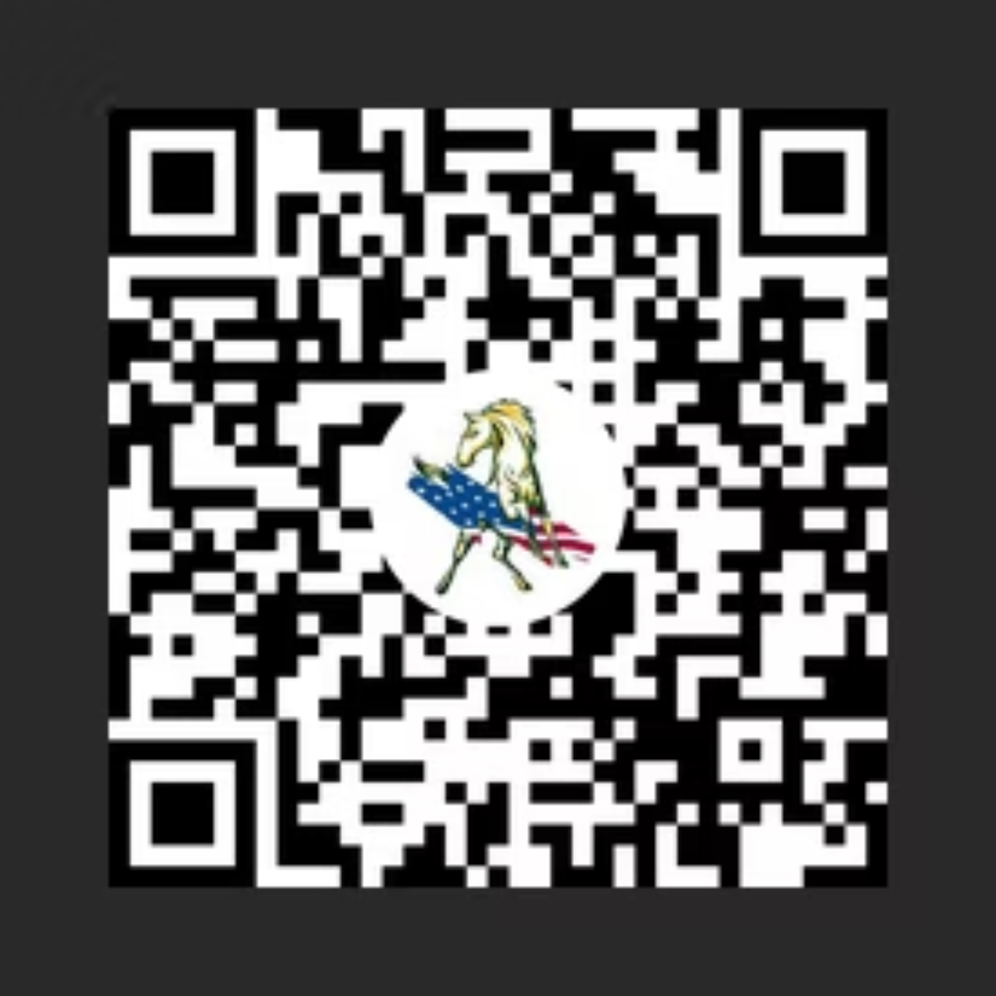
Thank You!

